Slide 1
Take home test #3 Anthony Ramos CSC342/43 spring 2021

Slide 2

Objective
Implement a program to compute dot product using Pointer Arithmetic (discussed here)
Utilize QueryPerformanceCounter() to measure execution times (Visual Studio Only)
Optimize compiler generated assembly code using vector instructions
Simulate in MS Visual Studio and Linux environments
Repeat using array indexing instead (See report)

Slide 3
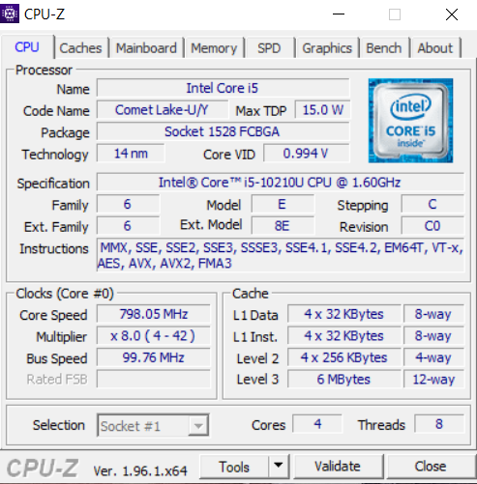

My CPU Info
My CPU’s instruction capabilities

Slide 4
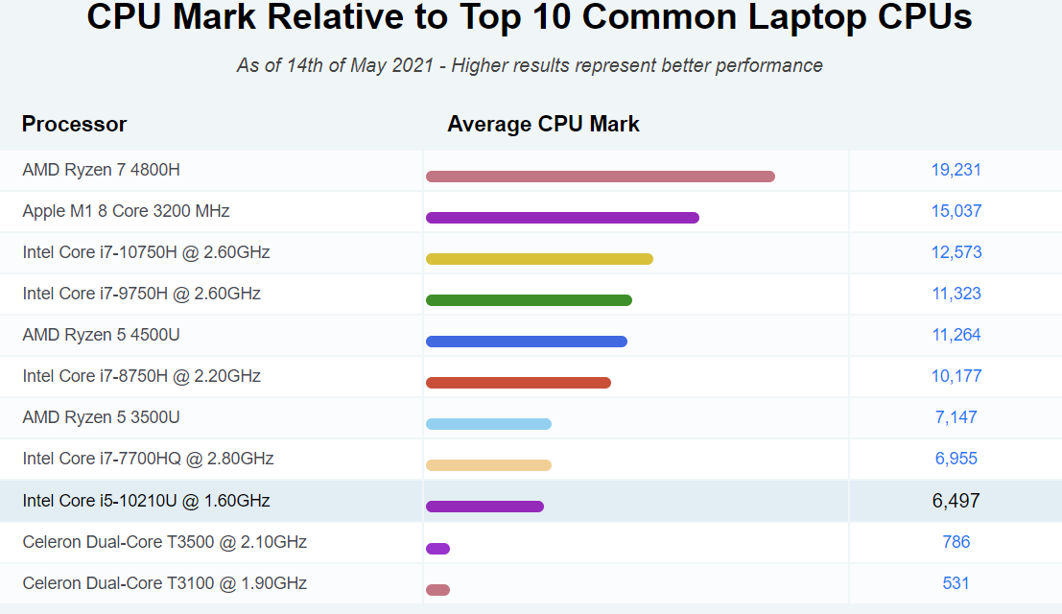
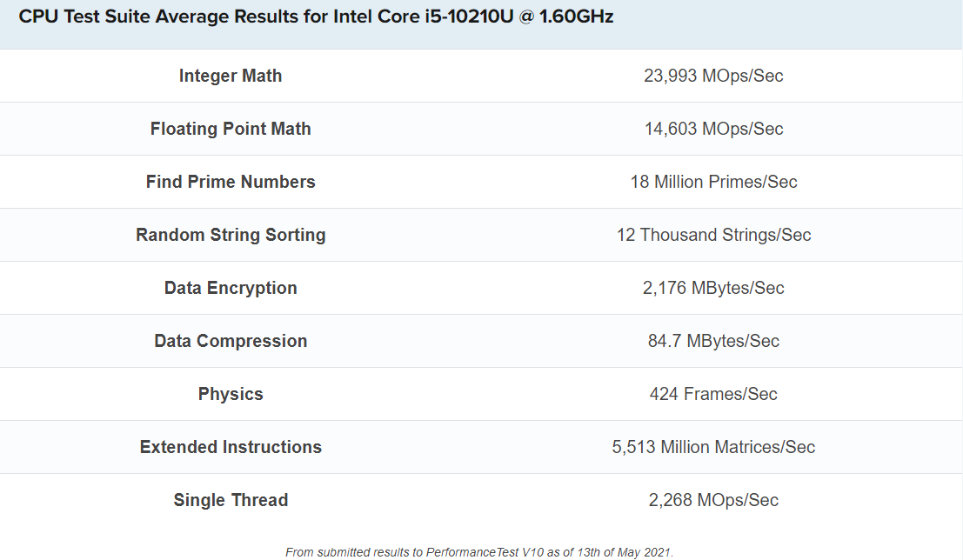
My CPU Info
(cpubenchmark.net)

Slide 5
Dot Product Program
See Report

Slide 6
QueryPerformancecounter()

Slide 7
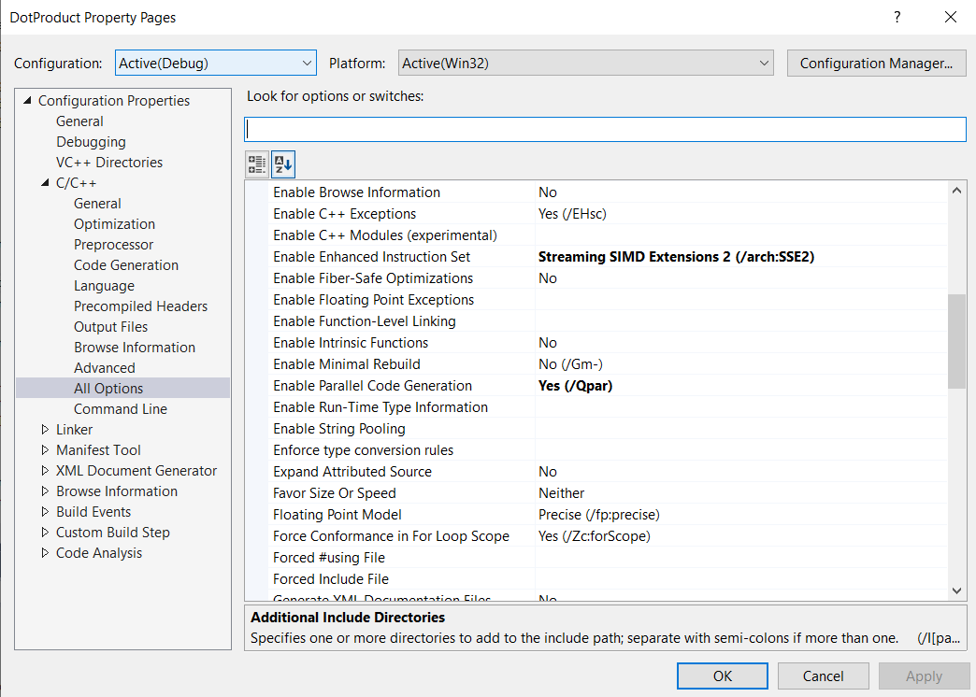
Optimization Settings (Auto parallelization/Vectorization)
Enable Auto
Vectorization
Enable Auto
Parallelization

Slide 8
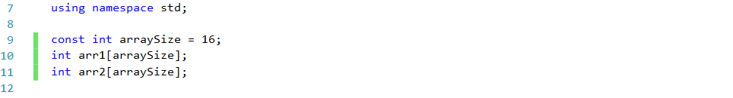
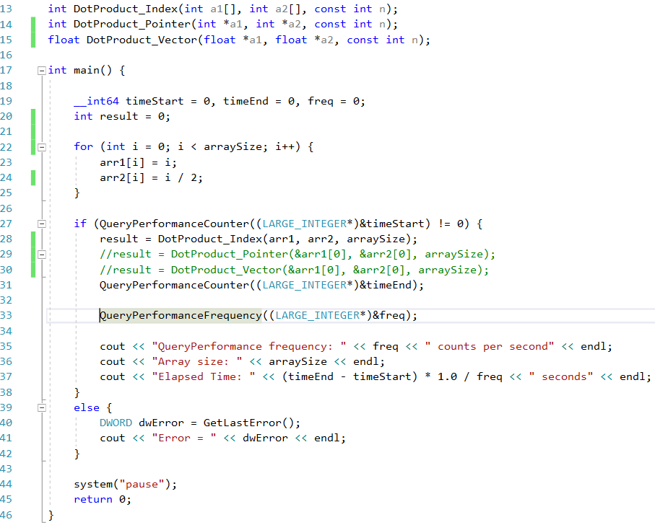
Test File
Link functions
Note: We must change the
datatypes of arr1, arr2, result, and i from int to float if we want to use test DotProduct_Vector()
Fill array values (we are not concerned with the result)
Dot Product (Array Indexing)
Dot Product (Pointer Arithmetic)
Dot Product (SSE3 Vector Instructions)

Slide 9
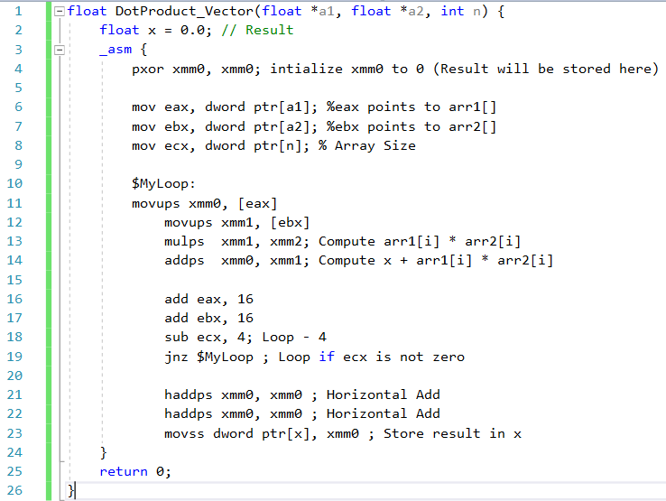
Dot Product (Vector Instructions)

Slide 10
results(MS Visual studio)

Slide 11
Optimization in a Linux environment
Optimization Flag | Optimization Level | Execution Time | Notes
-O0 | 0 (Default) | + | No Optimization
-O1 | 1 | - | Basic Optimization
-O2 | 2 | -- | Recommend Level
-O3 | 3 (Highest) | --- | Optimization Not Guaranteed
Attempts to
vectorize loops
GCC optimization - Gentoo Wiki
Optimize Options (Using the GNU Compiler Collection (GCC))

Slide 12
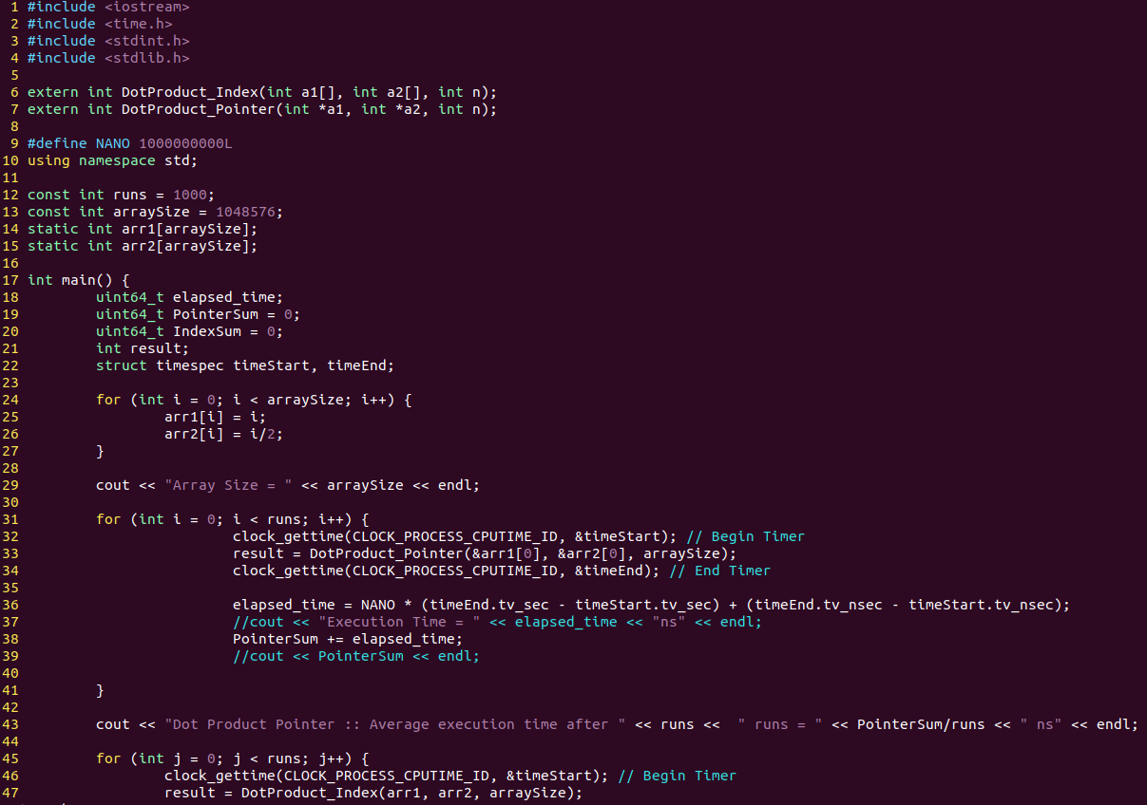
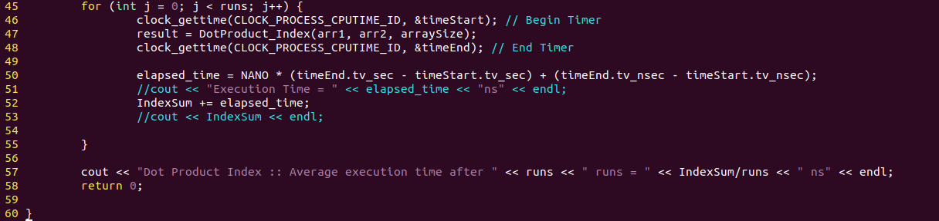
Optimization in a Linux environment
Call both functions via extern
clock_gettime()
Perform 1000 runs for each
program

Slide 13
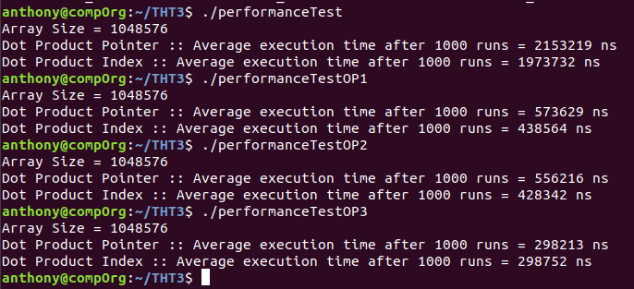
Optimization in a Linux environment
Optimization Flags
No Optimization
Level 1 Optimization
Level 2 Optimization
Level 3 Optimization

Slide 14
Results (Linux)
See report for results via array indexing

Slide 15
Thank You!

